Slide 1

Emergency Operations Manual
2013

Slide 2
Emergency Procedures,
Life Safety, and Security Plan
Parade
Festival
Block Parties
JP EDITION
BACK BAY EDITION
Version: 1
Date: 5-21-13
Document controller: Sylvain BRUNI

Slide 3
Index
Index 3
Goal & Purpose 4
Section 1 - Emergency Procedures 5
  Emergency Response Teams 6
  Emergency Evacuation Plan 7
  Emergency Announcement Plan 8
  Emergency Announcement 9
  Emergency Exit Rules & Safety 10
  Site Map - Boston Pride Parade 11
  Site Map - Boston Pride Festival 12
  Site Map - Boston Pride Block Party: JP Edition 13
  Site Map - Boston Pride Block Party: Back Bay Edition 14
  Crowd Manager Safety Checklist 15
  Incident Report 16
  First Aid - Medical 17
Section 2 - Life safety 18
  Weather Rules & Safety Plans 19
  Weather Threshold Action Plan 20
  Bomb Threat 21
  Protestors 22
  Unattended & Suspect Packages 23
  Food Illness Procedure 24
  Food Illness Report 25
  Cooking Grease Rules & Safety 26
  Propane Rules & Safety 27
  Diesel Fuel Rules & Safety 28
  Generator Rules & Safety 29
  Electric Cables 30
  Parade Vehicles - Inspection & Safety Criteria 31
  Parade - Onsite Rules & Regulations 33
  Festival - Onsite Rules & Regulations 34
  Festival Seating Rules & Safety 35
  Stage/Tent Collapse 36
  Block Parties - Onsite Rules & Regulations 37
  Bag Search Procedure 38
Section 3 - Security Plan 39
  General Measures 40
  Parade Measures 41
  Festival Measures 42
  Block Parties Measures 43
Section 4 - Appendices 44
  Emergency Directory 45
  Pride Staff Directory 46
  Contractors Directory 47
Boston Pride Emergency Operations Manual
3

Slide 4
Goal & Purpose
Our goal is to set up, operate, and tear down all Boston Pride events with zero damage and zero injuries. This manual is intended to set policies and procedures to attain our goal and to limit damage and injuries in case of an incident.
Boston Pride Emergency Operations Manual
4

Slide 5
Emergency procedures
Section 1

Slide 6
Emergency Response Teams (ERT)
Parade
Parade Chair Martha Plaza
Board Supervisor Malcolm Carey
Boston Police Liaison Javier Pagan
Boston Police Supervisor
EMT Supervisor
Special Events Director Patte Pappa
Pride President Linda J. DeMarco
Festival
Festival Chair Jonathan Kindron
Board Supervisor Linda J. DeMarco
Boston Police Liaison Javier Pagan
Boston Police Supervisor
EMT Supervisor
City Hall Plaza Supervisor Lisa Lamberti
Pride President Linda J. DeMarco
Block Party – JP Edition
Block Party Chair Jaiy Dickerson
Board Supervisor Malcolm Carey
Boston Police Liaison Javier Pagan
Boston Police Supervisor
EMT Supervisor
Special Events Director Patte Pappa
Pride President Linda J. DeMarco
Block Party – Back Bay Edition
Block Party Chair Rob Zuromski
Board Supervisor Sylvain Bruni
Boston Police Liaison Javier Pagan
Boston Police Supervisor
EMT Supervisor
Special Events Director Patte Pappa
Pride President Linda J DeMarco
Boston Pride Emergency Operations Manual
6

Slide 7
Emergency Evacuation Plan
The event chair or the board supervisor on the ERT informs dispatch of the area to evacuate. This information can only come from one of these two individuals or from the Boston Police or Boston Fire Department.
All entertainment stops and the event chair or the board supervisor makes announcements per the Emergency Announcement Plan, directing people to the nearest open space away from the incident or emergency exits in case of evacuation.
All members of the ERT and Security Staff go to their emergency assignments (per the following event maps).
Volunteers assist in the evacuation by directing people to the nearest open space or emergency exit. ERT coordinate personnel to secure the evacuated area until the situation has been declared resolved by the proper authority.
People are not allowed to re‑enter an evacuated area until the Police and the ERT have given the all clear. Whatever the circumstances, any message regarding re‑entry can only be authorized by the event chair or the board supervisor, is to be broadcast over radios.
Boston Pride Emergency Operations Manual
7

Slide 8
Emergency Announcement Plan
At the final event orientation, the ERT designates the event chair or the board supervisor who will make the emergency announcement.
After an emergency occurs, the ERT informs Security Staff, event volunteers and representatives from agencies present on the premises of the upcoming emergency announcement. Security Staff and event volunteers are asked to go to their emergency assignments.
The event chair or the board supervisor makes the emergency announcement over the public address system available at the event.
Boston Pride Emergency Operations Manual
8

Slide 9
Emergency Announcement
"THIS IS AN IMPORTANT MESSAGE THAT AFFECTS ALL OF YOU.”
“IT IS NECESSARY TO EVACUATE [insert event name].”
“PLEASE LEAVE IMMEDIATELY BY WALKING TO THE NEAREST EXIT AS QUICKLY AND QUIETLY AS POSSIBLE AND FOLLOW THE INSTRUCTIONS OF THE SECURITY STAFF AND PRIDE VOLUNTEERS ALONG THE WAY.”
“THE CLOSEST [select EMERGENCY EXIT/OPEN SPACE] IS IN THIS DIRECTION [point or announce the direction of the closest emergency exit or open space].”
Boston Pride Emergency Operations Manual
9

Slide 10
Emergency Exit Rules & Safety
Emergency exits must be fully open during all operating hours with security staff at each exit.
Emergency exits must have:
  Two weather resistant signs with red lettering visible from 75’ away, with the word “EXIT” clearly marked
Refer to individual site maps for each event location – on the following pages
  Boston Pride Parade………………………………………………. 11
  Boston Pride Festival …………………………………………….. 12
  Boston Pride Block Party – JP Edition…………………….. 13
  Boston Pride Block Party – Back Bay Edition………….. 14
Boston Pride Emergency Operations Manual
10

Slide 11
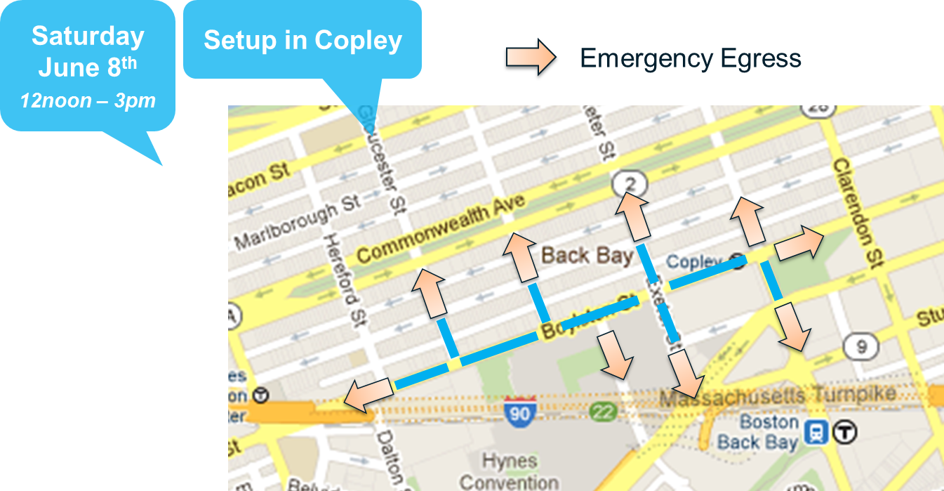
Site Map – Boston Pride Parade (staging area)
Boston Pride Emergency Operations Manual
11

Slide 12
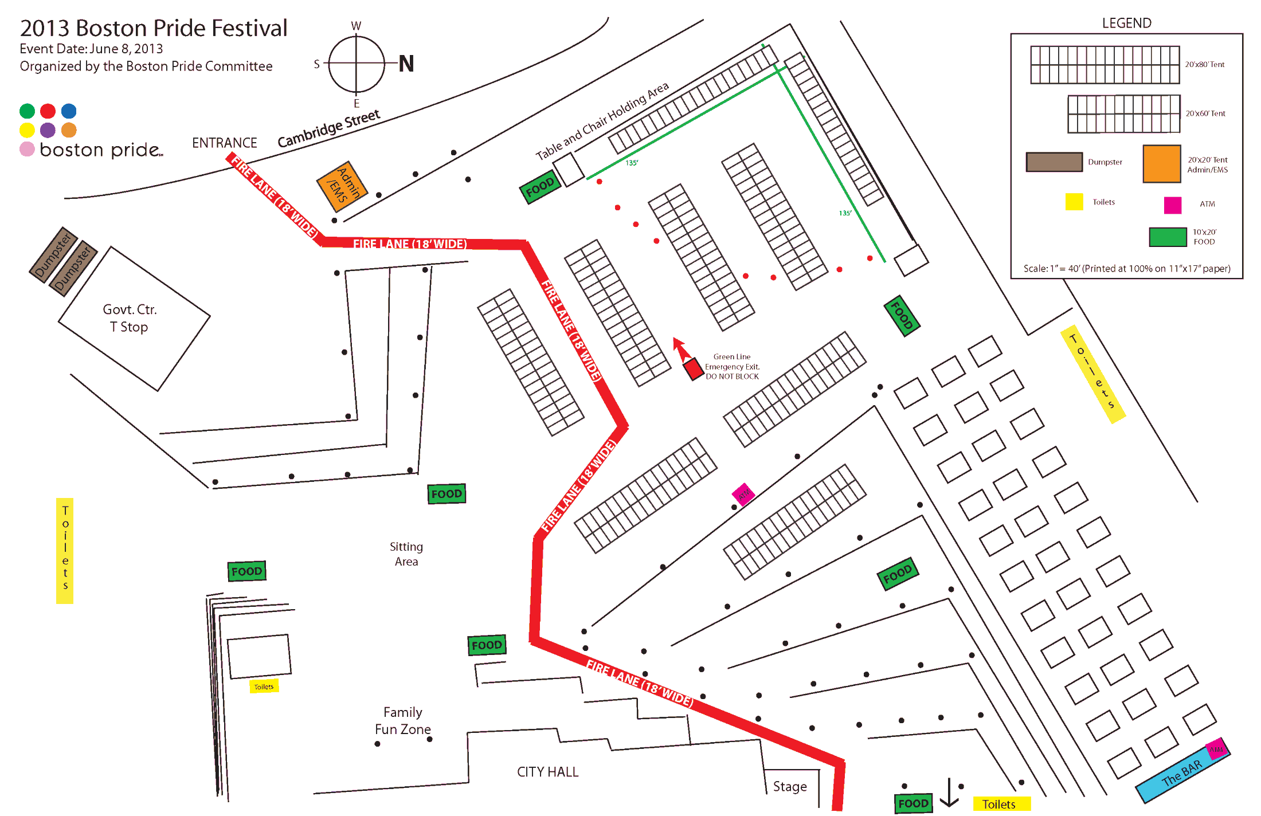
Site Map – Boston Pride Festival
Boston Pride Emergency Operations Manual
12

Slide 13
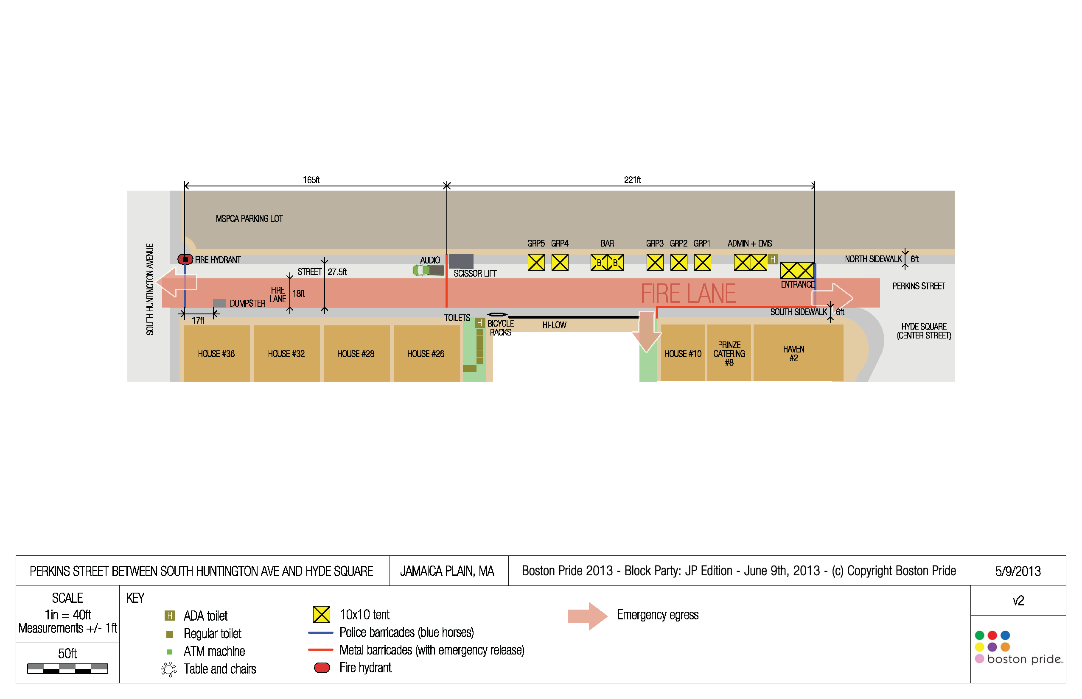
Site Map – Boston Pride Block Party: JP Edition
Boston Pride Emergency Operations Manual
13

Slide 14
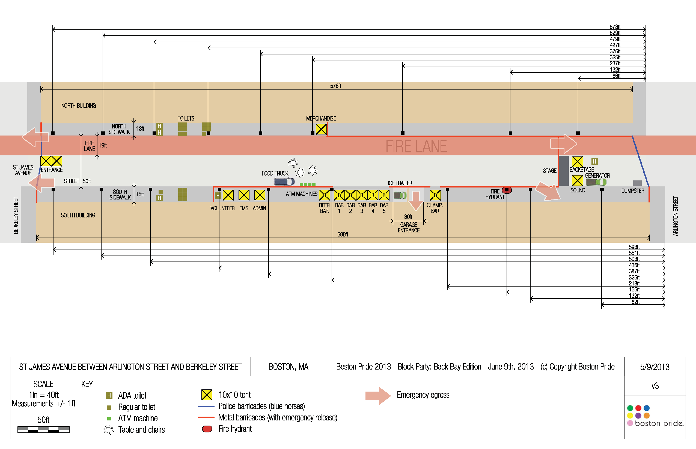
Site Map – Boston Pride Block Party: Back Bay Edition
Boston Pride Emergency Operations Manual
14

Slide 15
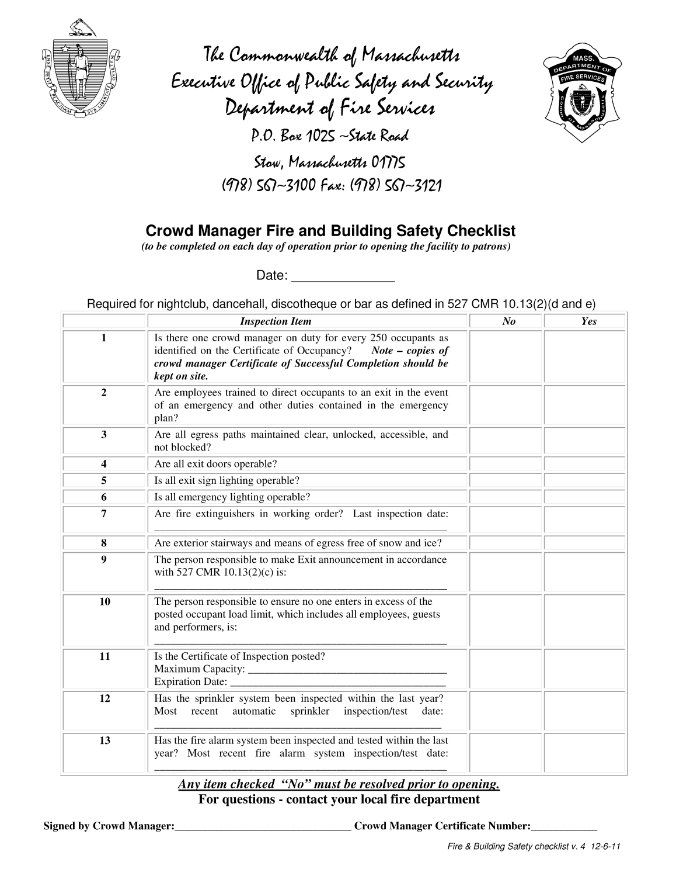
Crowd Manager
Safety Checklist
This form will be filled out prior
to all events.
Boston Pride Emergency Operations Manual
15

Slide 16
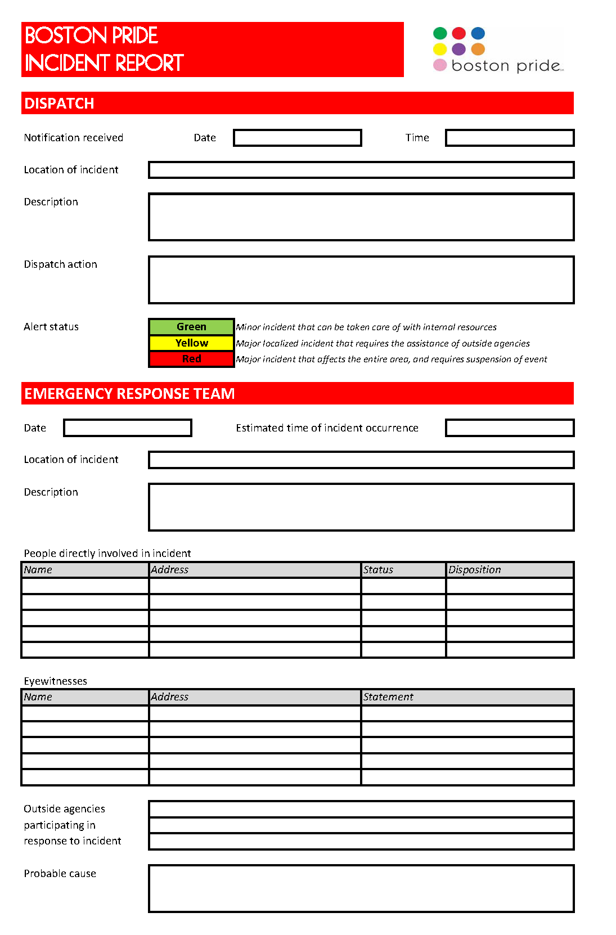
Incident
Report
This form will be available at all events.
Boston Pride Emergency Operations Manual
16

Slide 17
First Aid - Medical
Any person requiring basic first aid support, who can proceed under their own power without assistance, should be escorted to the EMS / First Aid tent. Any medical incident requiring a greater level of medical assistance must be referred to Boston EMS immediately with details of the nature of the injury and the location. The person reporting the incident should stay on the scene until the EMT arrives.
KNOWING THE EXACT LOCATION OF THE MEDICAL EMERGENCY IS CRITICAL
It will be the responsibility of the EMT to determine the necessity of sending the injured person to the hospital via ambulance. For all transports, EMTs will need to contact the Boston Pride event chair or board supervisory, and give them the name and phone number of each person being transported.
Boston Pride Emergency Operations Manual
17

Slide 18
Life safety
Section 2

Slide 19
Weather Rules & Safety Plans
Boston Pride Events occur Rain or Shine
Boston Pride works closely with City of Boston Officials to monitor weather events as necessary.
If a weather-related threat is imminent, notification of event cancellation will be announced via standard broadcast media (radio, internet, email).
During an event, if a hazardous weather condition develops, the event chair will help facilitate the disruption, evacuation, or termination of the event.
Boston Pride Emergency Operations Manual
19

Slide 20
Weather Threshold Action Plan
Precipitation
  Light rain for short duration (one hour or less) – no action
  Light rain for extended time (over one hour) – be ready to close festival based on park conditions. Any rain that starts to produce ponding water will result in the closure of the festival. Ponding water on roof of Festival Stage will reduce load capabilities, Roof must be lowered and any ponding water removed (contractor responsible).
  Medium to Heavy Rain – closure of festival.
Thunderstorm Storm
  Thunderstorms have heavy rain, hail, wind, and lightening, and our goal is to have the Festival and/or Parade area cleared of all patrons BEFORE a thunderstorm affects the area. This is not always possible if the storm forms over the area. The Festival will close if a Thunderstorm Storm is on radar (or observed by ground observers), is heading towards the festival grounds, and its arrival is within 45 minutes of the festival grounds. Just a forecast of Thunderstorms Storms will not close the festival. If the NWS Issues a Severe Weather Warning (Severe Thunderstorm, Flood, Tornado, Dust Storm) for the Festival/Parade area, then the Festival will be closed immediately (unless based on real time RADAR data, the storm can be identified and will miss the area by at least 10 miles; however in that case we will still make announcements in every venue and at all entrances of the Weather Warning).
Boston Pride Emergency Operations Manual
20

Slide 21
Bomb Threat
Any bomb threats will be passed on to the Emergency Response Team. The Emergency Response Team will contact the appropriate agencies (FBI, Bomb Squad, Homeland Defense, etc.) to be advised as the next course of action, which may include site evacuation. Operations Dispatch will NOT broadcast an Alert Status until the ERT decides the validity of the threat.
If deemed necessary, a Code Yellow or Red Status will be declared by the Emergency Response Team, at which time Operations Dispatch will initiate the emergency announcement plan and broadcast the alert.
Boston Pride Emergency Operations Manual
21

Slide 22
Protestors
Boston Pride recognizes and cherishes the rights of people to protest and exercise their First Amendment rights at our events.
A Free Speech area shall be designated outside the Festival area and along the Parade route for that purpose if we are informed ahead of time that demonstrators will be in attendance.
If a protest activity occurs without advance warning during the event, the ERT will decide an appropriate course of action. Unless the protest is violent or unduly disruptive to the event there should be no effort made to suppress the protest unless it is inside the Festival. All actions will be determined to assure the safety of event attendees whether inside or outside of the event. Inside the festival, protesters will be escorted out of the festival area by volunteer security personnel.
Boston Pride Emergency Operations Manual
22

Slide 23
Unattended & Suspect Packages
If a suspect package giving concern is discovered anywhere in or immediately adjacent to the Festival area or Parade route, it should be reported to the ERT immediately. The package should be left undisturbed.
The Boston Police Coordinator, as a part of the ERT, will decide if the package might pose a threat, and if additional support is needed, and will coordinate and obtain that support.
If it is determined the package might pose a threat, the ERT will immediately evacuate the public and non-essential volunteers from the vicinity of the suspect package. The area will be secured, including halting the Parade or Festival activities if needed, BPD will have control of the area until such time as it has been cleared by the BPD.
If no threat is identified, the package is to be brought to the lost and found area.
Boston Pride Emergency Operations Manual
23

Slide 24
Food Illness Procedures
All food and beverage vendors operate under MCESD “Special Events” rules and regulations
Wash stations will include: a 5-gallon-minimum insulated container with free flowing spigot with a waste container 15% larger, soap, paper towels. Proper hand washing must be conducted during the event. Bare hand contact of ready to eat food items is prohibited.
All food and condiments have proper protection (lids, sneeze guards) to prevent contamination of food. Grills with open, unprotected food are protected from the public by a barrier (table and sneeze guard).
Booths have a proper canopy over the food, as well as walls to prevent contamination of food.
A smooth, easily cleanable surface should be present in all booths for flooring. All food should be stored at least 12 inches off the ground.
Ice chests and reach-in refrigerators are acceptable to maintain all cold hazardous food at less than 41F. If using electrical equipment, ensure the refrigerator reaches an ambient air temperature of 41F prior to placing food in the fridge. A probe thermometer should be available to check temperatures.
Electric or propane equipment is acceptable to hold hot hazardous food at greater than 135F. Utensils shall be properly stored when not in use. Non-latex gloves are required when handling any ready to eat food items.
Cooking equipment should be sufficient to heat food rapidly to proper cooking temperatures. All equipment should be in good, easily cleanable condition.
Fresh water should be obtained through a proper NSF / food-grade white hose. The ends of the hose shall remain connected when not in use. Bottled water from an approved source is also acceptable.
A metal stem thermometer that measures from 0F to 220F must be available and used to check food temperatures. An accurate thermometer will read 32F in a cup full of ice water.
  Cook Poultry/Reheat Foods to 165F
  Cook Ground Meat to 155F
  Cook Non-Ground Meat and Seafood to 145F
  Hot Holding is 135F
  Cold Holding is 41F
All homemade food products are prohibited.
Commissary agreements are required for all advance food preparation and food storage. Vendors that prepare food in advance of an event must use a licensed facility.
Boston Pride Emergency Operations Manual
24

Slide 25
Food Illness Report
If guests report intestinal and or digestive issues in large numbers to either Pride volunteers or the EMT on site, the EMT will determine what each person ate, and from what vendor in an effort to identify a potential food borne contaminated source. If a source can be identified, Pride will, it its sole opinion, close the food vendor, contact BISD, and post security at food vendor to prevent any tampering or continued selling. The effected food vendor will not be eligible for any return of monies for the time they were not allowed to sell.
Boston Pride Emergency Operations Manual
25

Slide 26

Cooking Grease Rules & Safety
Cooking using grease is only allowed by food vendors and is subject to Health Department and Fire Department rules and regulations. Used cooking grease MUST be placed in Baker Commodities containers provided by Pride in each of the food courts.
Animal Fats grease – a 20BC Fire extinguisher must be at each booth using Animal fats for fryers, with compliant inspection tag.
Vegetable Oil grease – a Class K Fire extinguisher must be at each booth using Vegetable oils for fryers, with compliant inspection tag.
COOKING GREASE IS A FLAMMABLE LIQUID
Ignites easily
Burns rapidly
DO NOT use water or flour to put out a cooking grease fire!
  Water makes fire bigger
  Flour can explode

Slide 27
Propane Rules & Safety
Propane tanks are only authorized to be used by food vendors in conjunction with cooking operations. Tanks not in use must be stored on a firm surface and away from any source of ignition in upright secured position. No more than 100 lbs are allowed inside a booth. Tanks in use must be in upright secured position, not within 10’ of exits or tent walls, and connected hose must be 36” or less and be marked as “LP-Gas, Propane, 350 PSI WORKING PRESSURE” along with manufacturers name/trademark.
Health Hazards
  Contact with liquid or cold vapor may cause frostbite, freeze burns, and permanent eye damage
  Contact to mucous membranes with liquefied product may cause frostbite and freeze burns. Signs of frostbite include a change in the color of the skin to gray or white, possibly followed by blistering. Skin may become inflamed and painful.
First Aid
  EYES In case of contact with eyes, immediately flush with clean, low-pressure water for at least 15 min. Hold eyelids open to ensure adequate flushing. Seek medical attention.
  SKIN Remove contaminated clothing. Wash contaminated areas thoroughly with soap and water or waterless hand cleanser. Obtain medical attention if irritation or redness develops.
  INGESTION Risk of ingestion is extremely low. However, in cases of ingestion or oral exposure, seek immediate medical attention.
  INHALATION Remove person to fresh air. If person is not breathing, provide artificial respiration. If necessary, provide additional oxygen once breathing is restored if trained to do so. Seek medical attention immediately.
FIRE AND EXPLOSION HAZARDS Liquid releases flammable vapors at well below ambient temperatures and readily forms a flammable mixture with air. Dangerous fire and explosion hazard when exposed to heat, sparks or flame. Vapors are heavier than air and may travel long distances to a point of ignition and flash back. Container may explode in heat or fire. Runoff to sewer may cause fire or explosion hazard.
EXTINGUISHING MEDIA Dry chemical, carbon dioxide, Halon or water. However, fire should not be extinguished unless flow of gas can be immediately stopped.
Boston Pride Emergency Operations Manual
27

Slide 28
Diesel Fuel Rules & Safety
Diesel fuel is prohibited on site except when used to provide power for contractors equipment and generators and portable lights. All stationary diesel fueled equipment must have absorbent mats placed under motors and fuel tanks to catch small fuel spills.
COMBUSTIBLE LIQUID
Vapors may be ignited rapidly when exposed to heat, spark, open flame or other source.
EFFECTS CENTRAL NERVOUS SYSTEM - HARMFUL OR FATAL IF SWALLOWED
Moderate fire hazard. Avoid breathing vapors or mists. May cause dizziness and drowsiness. May cause moderate eye irritation and skin irritation (rash). Long-term, repeated exposure may cause skin cancer. If ingested, do NOT induce vomiting, as this may cause chemical pneumonia (fluid in the lungs).
FIRST AID
EYES In case of contact with eyes, immediately flush with clean, low-pressure water for at least 15 min. Hold eyelids open to ensure adequate flushing. Seek medical attention.
SKIN Remove contaminated clothing. Wash contaminated areas thoroughly with soap and water or waterless hand cleanser. Obtain medical attention if irritation or redness develops.
INGESTION DO NOT INDUCE VOMITING. Do not give liquids. Obtain immediate medical attention. If spontaneous vomiting occurs, lean victim forward to reduce the risk of aspiration. Monitor for breathing difficulties. Small amounts of material which enter the mouth should be rinsed out until the taste is dissipated.
INHALATION Remove person to fresh air. If person is not breathing provide artificial respiration. If necessary, provide additional oxygen once breathing is restored if trained to do so. Seek medical attention immediately.
FIRE EXTINGUISHERS
Any extinguisher suitable for Class B fires, dry chemical, CO2, water spray, fire fighting foam, or Halon.

Slide 29
Generator Rules & Safety
The City of Boston does not permit the use of gas-powered generators!
Only electric generators are allowed on Festival grounds and must be located at least 20 feet from tents, parked vehicles, or structures. Each generator must be permitted by City of Boston, and adhere to City of Boston rules and regulations.
Diesel-fuel generators can only be used in the Parade, they are prohibited on Festival grounds
COMBUSTIBLE LIQUID Vapors may be ignited rapidly when exposed to heat, spark, open flame or other source
EFFECTS CENTRAL NERVOUS SYSTEM - HARMFUL OR FATAL IF SWALLOWED
Moderate fire hazard. Avoid breathing vapors or mists. May cause dizziness and drowsiness. May cause moderate eye irritation and skin irritation (rash). Long-term, repeated exposure may cause skin cancer. If ingested, do NOT induce vomiting, as this may cause chemical pneumonia (fluid in the lungs).
FIRST AID
  EYES In case of contact with eyes, immediately flush with clean, low-pressure water for at least 15 min. Hold eyelids open to ensure adequate flushing. Seek medical attention.
  SKIN Remove contaminated clothing. Wash contaminated areas thoroughly with soap and water or waterless hand cleanser. Obtain medical attention if irritation or redness develops.
  INGESTION DO NOT INDUCE VOMITING. Do not give liquids. Obtain immediate medical attention. If spontaneous vomiting occurs, lean victim forward to reduce the risk of aspiration. Monitor for breathing difficulties. Small amounts of material which enter the mouth should be rinsed out until the taste is dissipated.
  INHALATION Remove person to fresh air. If person is not breathing provide artificial respiration. If necessary, provide additional oxygen once breathing is restored if trained to do so. Seek medical attention immediately.
FIRE EXTINGUISHERS Any extinguisher suitable for Class B fires, dry chemical, CO2, water spray, fire fighting foam, or Halon.
Boston Pride Emergency Operations Manual
29

Slide 30
Electric Cables
Electric cables and cords outside of those kept within booths must be provided by Pride. Electric cables must be protected by cable ramps in places where they could be a tripping hazard or they could be punctured or accidently damaged.
The city requires that all connections be 3” above ground to protect from ponding of water.
Cable ramps must be used for all cable runs where the public could trip over the cable.
Boston Pride Emergency Operations Manual
30

Slide 31
Parade Vehicles - Inspection & Safety Criteria
All vehicles participating in the Boston Pride Parade will be inspected, to ensure compliance with the following Rules & Regulations. These regulations are to ensure everyone’s safety throughout the event.
No Hazardous Materials allowed
Drivers:
All drivers must have, in their possession:
  a valid driver’s license in tier possession
  a valid, unexpired registration for the vehicle they are operating
All CDL drivers must be in compliance with FMCSA (Federal Motor Carrier Safety Act)
All CDL drivers must have a current medical card in their possession
Each driver is legally responsible for the actions of persons in/on their vehicle or float.
Boston Pride Emergency Operations Manual
31

Slide 32
Parade Vehicles - Inspection & Safety Criteria
Vehicles:
All CDL vehicles must be in compliance with FMCSA
All vehicles, trailers, and floats must be properly registered
All vehicles must have a valid state inspection
All vehicles, including floats, must have working brake lights and turn signals
All vehicles, including floats, must have properly functioning brakes, including air brakes
No vehicles with defective tires, suspension defects, or visible fuel leaks will be allowed to participate in the parade
Only single trailer/float units are allowed.
No overweight or over height vehicles will be allowed.
No oversize floats or vehicles.
  Maximum width of 102 inches.
  Maximum length of trailer depends on the parade route – but cannot exceed 53 feet.
  Maximum height is 13 feet, 6 inches. This includes standees on a float or trailer.
All floats and trailers must use safety chains.
All props on floats and trailers must be properly secured, braced, or tied down to prevent movement during vehicle operation.
All floats and trailers must provide adequate safety measures for all riders, to prevent falling from platforms.
  Hand holds must be provided for each rider.
  No getting on an doff truck beds, trailers, or floats during operation. No throwing of candy, beads, or any other material from any vehicle in the parade, is permitted.
No staging to be build on trailer bed unless load conforms to all applicable State and Federal Safety Regulations
No music or excessive noise emanation within Staging Area
No cylinders of any type are allowed.
No Gas or Fuel containers allowed
No gasoline powered generators are allowed
Boston Pride Emergency Operations Manual
32

Slide 33
Parade – Onsite Rules & Regulations
BOSTON PRIDE CODE OF CONDUCT
When organizing your Parade group, please consider the diversity of the community and audience at the event. People participate in Boston Pride for many reasons: to celebrate, to make a political statement, to have fun, to showcase their business or group, to include family members, and to show support. The Boston Pride Committee respects everyone’s right to express themselves as they choose. The Boston Pride Committee is not a law enforcement agency and does not participate as a law enforcement agency. The Boston Pride Committee does not endorse or encourage illegal behavior by anyone participating in or attending the event. Additionally, the Boston Pride Committee does not support any form of homophobia or attempt to censor freedom of speech or freedom of expression so long as it does not infringe on the rights of others. The Boston Pride Committee is the permit holder for this event and reserves the right to deny participation and/or registration of any group or individual who may be considered unacceptable to participate by the rules of such permit and the community. The Boston Pride Committee will abide by all Massachusetts laws governing public decency. Any individual or group who violates these laws may be removed from the event by the City of Boston.
BY SUBMITTING A PARADE APPLICATION YOU AGREE TO THE FOLLOWING RULES & REGULATIONS:
1. Have two (2) Marshals serve as points of contact between the Parade staff and your group. Marshals are required to attend one Marshal Orientation Meeting prior to the Parade. The representatives from your organization attending the Orientation Meetings must be the same persons who will act as Marshals on the day of the Parade. If that is not the case, your organization will not be allowed to march in the Parade. Marshals must enforce the instructions provided by the Parade staff. Failure to comply with said instructions will result in the removal of your group from the Parade and possible exclusion from future Pride Parades.
2. Follow all instructions from the Parade staff. Any float, vehicle, or motorcycle, which is operated against instructions, will be removed from the Parade and may be subject to fines and exclusion from future Pride Parades.
3. Have at least two (2) safety volunteers from your organization who will be responsible for walking on each side of each vehicle, motorcycle group, or float to ensure the safety of all involved and alert drivers to potential problems. Failure to provide such volunteers may result in exclusion from the Parade. These volunteers are in addition to the Group Marshals you have registered.
4. Have adequate insurance for your vehicles on the day of the Parade. The Boston Pride Committee and the City of Boston are not liable for any accidents or injuries that are due to motor vehicles, floats, or motorcycles. Said insurance must be present with the vehicle on the day of the Parade. All drivers of any vehicles must check in at the Parade Registration tent and show a valid driver’s license to Parade staff and to law enforcement officials upon request.
5. Have no open or closed containers of alcoholic beverages. If alcoholic beverages are discovered, the vehicle and/or its associates will be removed from the Parade.
6. Make sure that objects are not thrown at spectators (including Police Officers) along the Parade route.
7. Proceed so as not to impede the orderly flow of the Parade. Groups shall not move too quickly or stop unless instructed to. Any vehicle, float, or motorcycle that experiences any mechanical difficulty must pull to the side of the road to allow others to proceed.
8. Enter and exit the Parade route as instructed by the Parade staff and the Boston Police Department.
9. TURN OFF ALL SOUND SYSTEMS BETWEEN 6:00 AM AND 11:30 AM so as to not interfere with church ceremonies and neighbors in the area. Sound checks should be done prior to staging. If instructed, sound systems must be turned off at any time during the Parade.
10. Respect one minute of silence at 12 noon and enforce this respect within your group.
11. Refrain from collecting monetary donations along the Parade route. Failure to comply will result in the removal of your group from the Parade and possible exclusion from future Pride Parades.
12. Respect the maximum authorized vehicle sizes. Per City of Boston regulations, no vehicle in the Parade is allowed to exceed the following size limits: 9 feet in width, 12 feet in height, and 30 feet in length. In addition, only one flatbed is allowed per registered vehicle: combinations of trailers, or flatbeds and trailers will not be allowed.
CONTRACT TERMS:
1. "Right to Refuse:" Boston Pride reserves the right to refuse any application. Receipt of your application and payment does not imply acceptance of your application. Acceptance in the Parade line-up will be expressly notified by the Boston Pride Committee by email or postal mail once your application and full payment have been received, reviewed and accepted.
2. "Right to Dismiss:" Boston Pride reserves the right to refuse and dismiss your contingent's participation in the Parade on the day of the event if any of your vehicles does not satisfy the Parade Vehicle Inspection Criteria established by the Boston Police Department and available on the Pride website, or if your contingent is in clear violation of the Parade Rules and Regulations.
3. "Day-Of Fee:" Boston Pride reserves the right to charge you a fee on the day of the Parade if your contingent is different from what you have specified in this application (different number/type of vehicle etc...). This fee is established based on the fee schedule at the date of your first payment.
4. "No Refunds:" All fees paid are non-refundable.
5. "True Identity:" You are signing up for who you say you are and cannot sell your spot in the Parade. The organization's name you enter in this application must be that of the group participating in the Parade. You may not give, sell or share your spot in the Parade to any other group without prior written agreement from the Boston Pride Committee. If you are an advertising agency or marketing company registering for one of your clients, you must indicate so. If you plan on displaying advertisers' logos and/or any other such visual displays other than those representing your organization, you must receive prior written approval by the Boston Pride Committee.
6. "Single Banner Rule:" This registration is valid for your group and your group only. You may not have signs, banners or any other display in your contingent representing or advertising for entities other than your own group as registered in this application.
7. "Finality of Decisions:" All decisions made by the Boston Pride Committee are final.
Boston Pride Emergency Operations Manual
33

Slide 34
Festival – Onsite Rules & Regulations
BOSTON PRIDE CODE OF CONDUCT
When organizing your exhibit, please consider the diversity of the community and audience at the event. People participate in Boston Pride for many reasons: to celebrate, to make a political statement, to have fun, to showcase their business or group, to include family members, and to show support. The Boston Pride Committee respects everyone’s right to express themselves as they choose. The Boston Pride Committee is not a law enforcement agency and does not participate as a law enforcement agency. The Boston Pride Committee does not endorse or encourage illegal behavior by anyone participating in or attending the event. Additionally, the Boston Pride Committee does not support any form of homophobia or attempt to censor freedom of speech or freedom of expression so long as it does not infringe on the rights of others. The Boston Pride Committee is the permit holder for this event and reserves the right to deny participation and/or registration of any group or individual who may be considered unacceptable to participate by the rules of such permit and the community. The Boston Pride Committee will abide by all Massachusetts laws governing public decency. Any individual or group who violates these laws may be removed from the event by the City of Boston.
BY SUBMITTING A FESTIVAL APPLICATION YOU AGREE TO THE FOLLOWING RULES & REGULATIONS:
1. CONTRACT FOR SPACE
This application for space, accompanied by full payment, constitutes a contract for the right to use vendor space for the one-day Festival on Saturday, June 8, 2013. The Boston Pride Committee reserves the right to make the final determination of all booth assignments in the best interest of the Festival. The Festival is a Rain or Shine event.
Contract space includes the tented "booth" space and 5 feet in front of that space only. Vendors are not permitted to do any solicitation outside of this space. This includes canvassing, handing out materials, or selling goods as a few examples. Such activity is permitted inside the booth and within the five feet space in front of the rented booth only. Please contact festival@bostonpride.org before the day of the event with any questions regarding this matter.
2. PAYMENT FOR SPACE
Applications must be accompanied by a check or online payment made payable to “Boston Pride” in U.S. funds, for 100% of the booth space purchased. CHECK PAYMENTS MUST BE POSTMARKED BY THE END DATE OF THE REGISTRATION FEE PERIOD IN WHICH YOU ARE REGISTERING. In the event payment is postmarked after the deadline, you will be charged the most current fee to compensate for the difference in prices.
The Boston Pride Committee has a NO REFUND policy for paid registrations. Upon cancellation, vendors may request a receipt denoting the amount of their registration as a donation to Boston Pride.
3. CONFIRMATION
Each vendor will receive a confirmation letter or email regarding their application’s acceptance. If you do not receive your confirmation by June 1, 2013, please contact the Festival Sub-Committee directly by emailing festival@bostonpride.org.
4. CHECK-IN
A registration booth will be set up on Boston City Hall Plaza at 7:00am on Saturday, June 8, 2013. The registration booth closes at 9:30am and any vendor booth not occupied by that time may be reassigned or forfeited to Boston Pride without refund of the rental charge.
4A. WITH VEHICLE: Vendors who wish to bring a vehicle onto City Hall Plaza must indicate as such on their online registration. Note that there is an additional fee for vehicle access. Access is restricted to 2-axle vehicles only. There are no exceptions to this rule.
Enter the Plaza from Cambridge Street and exit only via Court Street. Festival staff and posted signage will be available to direct you on and off the Plaza.
All vendors with vehicle access must check-in at their designated arrival time to receive their assigned booth, which will be assigned and emailed to you prior to the day of the festival. Your arrival time will be strictly enforced and no vehicles will be allowed on the Plaza before or after their scheduled arrival time. Upon check-in, vendors will be given a 15 minute Vehicle Access Pass. Additional time will not be permitted.
4B. WITHOUT VEHICLE: Vendors who do not require vehicle access will not be subject to a specific arrival time, but must be checked in between 7:00 - 9:30am as well. In order to avoid delays and parking problems, all vendors are encouraged to arrive early. The Boston Pride Committee will accommodate walk-up vendors on a first-come, first-serve basis.
5. INSTALLATION
Vendors may begin installation immediately following registration check-in. Installation must be completed by 11:00am. Please bear in mind that this rule applies to those participating in the parade as well. Booths must be fully assembled no later than 11:00am.
6. TABLES AND CHAIRS
At check-in, a $20 cash deposit will be required for your booth and equipment. You will be issued a receipt that you will take to the table and chair area to receive your equipment. Please save the receipt, as it will be needed at the end of the Festival to receive your deposit back. At the end of the Festival (6pm), YOU ARE REQUIRED TO RETURN YOUR EQUIPMENT AND YOUR RECEIPT TO THE DESIGNATED AREA in order to receive your $20 refund. If your group chooses to leave before 6pm, your table and chair deposit will NOT BE REFUNDED UNDER ANY CIRCUMSTANCES and will be considered a donation to Boston Pride.
7. DISMANTLING
The Festival ends at 6pm on Saturday, June 8, 2013. All vendor business must be concluded at this time. Vendors are required to clean their own booth and leave the premises in the same condition as they found it. If your booth is not cleaned, a fee of $25 will be billed to your organization to cover the cost of cleaning.
If vehicle access is required for breaking down your booth space, it must be purchased at the time of registration.
8. LIABILITY
The Boston Pride Committee, its officers, staff members and volunteers, and the City of Boston shall NOT be responsible for the safety of the property of the vendors from theft, damage by fire, accident, or any other cause whatsoever. Each vendor shall hold an insurance policy that names the Boston Pride Committee and the City of Boston as additional insured.
9. USE OF SPACE
Booth space and all exhibits must conform to prevailing applicable regulations of the City of Boston Fire Department and Inspectional Services Department. A copy of the regulations may be obtained through the City of Boston.
10. RESTRICTIONS ON OPERATION OF EXHIBIT
The City of Boston, City Hall, and/or the Boston Pride Committee reserve the right to restrict exhibits which become objectionable for any reason, including but not limited to noise, method of operation, or materials. The City of Boston, City Hall, and/or the Boston Pride Committee also reserve the right to prohibit any exhibit that, in the opinion of the City of Boston, City Hall, and/or the Boston Pride Committee, may detract from the general character of the exhibit as a whole. This reservation includes persons, things, conduct, printed matter, or anything of a character that the City of Boston, City Hall, and/or the Boston Pride Committee determine is objectionable to the exhibit or the Festival.
Stickers: The free distribution of stickers is not permitted by the Boston Pride Committee, City Hall, or the City of Boston. Clean-up fees charged by the City of Boston to remove stickers from public areas, buildings, plazas, etc., will be passed along to the appropriate vendor.
Food & Beverage: The sale or distribution of ANY food or beverage is STRICTLY PROHIBITED, except by registered food vendors. This includes water and soda. If you have any questions or are interested in becoming an Official Food Vendor, please contact festival@bostonpride.org prior to the festival.
11. COMMUNICATING WITH DEAF AND HARD OF HEARING INDIVIDUALS
Did you know that 10% of the American population is deaf or hard of hearing and there are thousands of deaf/hard of hearing individuals in the Greater Boston area? To make sure that you are reaching this large and diverse population, please provide information in visible/written format. If you are selling merchandise or clothing, use posters, banners, brochures, or signs to mark prices and sizes so that customers who are deaf/hard of hearing can easily shop at your booth. Consider providing a laminated menu or sample items of different sizes marked with prices, so that deaf/hard of hearing visitors can communicate efficiently with you. Your cooperation to ensure equal access for deaf/hard of hearing people at Boston Pride is greatly appreciated.
Boston Pride Emergency Operations Manual
34

Slide 35
Festival Seating Rules & Safety
Festival seating, or standing in front of concert in a confined space, has been identified as a culprit in numerous crowd crush injuries and deaths. The NFPA states: “Festival seating at live entertainment events should be “expected to result in overcrowding and high audience density that may compromise public safety”.”
It is our responsibility to maintain crowd safety. We will utilize volunteers who have been trained and certified in Crowd Management practices. The volunteers are responsible for monitoring the crowd and removal of any hazards or removal of people in the way of hazards.
At each event, a Crowd Manager Safety Checklist will be filled out, as provided by the Commonwealth of Massachusetts Office of Public Safety and Security.
Refer to the checklist included on the next page.
Boston Pride Emergency Operations Manual
35

Slide 36
Stage/Tent Collapse
A collapse of a stage, disabled access viewing platform, tent, building, etc. may involve injury to large numbers of people and require a massive medical response. It may also result in the movement of a large number of people away from the incident site and other unforeseen situations.
Security will send personal to the site to assist in moving people away from the site and assisting any injured until emergency services arrives.
Operations Dispatch will maintain a list of all Pride people in the affected area, and their location and condition.
Boston Pride Emergency Operations Manual
36

Slide 37
Block Parties – Onsite Rules & Regulations
These rules apply to both block parties: JP Event and Back Bay Event
All guests will have their ID checked. Adults 21 and older will receive a wristband signaling their ability to order drinks. Guests 20 and younger will not receive a wristband.
  A designated team of trained volunteers will be in charge of checking IDs at the entrance
All bags, backpacks and purses will be searched, no exception (see procedure next).
No open container will be allowed inside the event area.
Re-entry to the event will be allowed only after re-entering guests have their ID checked again.
Boston Pride Emergency Operations Manual
37

Slide 38
Bag Search Procedure
1. Purpose
The purpose for establishing bag search procedures is to control items that are hand carried into the venue. The bag search procedures should be a part of the venue’s overall security plan and should be tested and evaluated as stated in the security plan. The bag search procedures should include information on:
  • Interacting with those individuals who are having their bag(s) searched;
  • Identifying the items that are of interest during the bag search;
  • Outlining the procedures to conduct a bag search; and
  • Responding to items discovered during the bag search procedures.
2. General
Bag searches should be required of everyone entering the venue on those days associated with the preparation for and execution of an event. This should include employees, contractors, teams/performers, media and official guests, as well as the ticket bearing public.
  • The venue should establish bag search procedures that state the actual implementation of bag search procedures. The level of search detail will depend upon the threat to the venue as determined by the venue’s security manager or appropriate venue representative.
  • All bags and containers that are hand carried into the venue are subject to search for items that are not permitted in the venue.
  • Bag searches should occur at a level of detail commensurate with the threat (e.g., from a simple glance into the bag all the way to emptying the contents of the bag).
  • Venue employees, contractors, and event staff should be trained in the overall bag search procedures and have knowledge of those items not allowed in the venue (see section 6) during nonevent and event days.
  • Trained bag search staff and bag search supervisors should perform the bag searches in the safest manner possible so that they identify and respond appropriately to items not permitted in the venue.
3. Consent and Right to Refuse
The venue should notify prospective employees and contractors that bag searches are a requirement of employment. Bag searches of ticket holders are voluntary, however, the venue should draft explicit language so that potential ticket purchasers are aware that their bags will be searched at the venue prior to entry, and failure to allow a bag search will result in denial of entry. This language must be made available through every means utilized by the venue to sell tickets (i.e., signage, pre-recorded gate messages, Web sites, etc.).
4. Addressing Adverse Mindset and Threatening Statements
The venue should prepare a list of questions that the ticket holders may ask, along with appropriate responses that address concerns relating to the venue’s bag search program. Each bag searcher should rehearse these responses as part of their bag search training program. This rehearsal preparation will prepare the bag searcher to address ticket
holders’ concerns and help diffuse any potential animosity toward the bag searcher along with providing a consistent message justifying the venue’s bag search program. There is often a degree of impatience among the crowd entering a venue for an event. Those responsible for conducting bag searches should ensure that they maintain control at the bag search locations without feeling pressured to rush through their bag search responsibilities. Ticket holders making threatening statements (e.g., “I have a bomb”) should be taken seriously. The bag searcher should be certain of what the ticket holder said by asking the ticket holder to repeat the statement if necessary. The ticket holder should be informed that their statements are taken seriously. The bag searcher should immediately notify event security, supervisors, and law enforcement of such statements.
5. Refusal of Bag Search
If a ticket holder refuses to comply with the bag search, bag searchers should contact the bag search supervisor to reinforce the bag search procedures as a requirement for entry into the venue. This process should be conducted in a non-combative manner by asking the ticket holder to stand aside from the bag search line to allow others to pass through while waiting for the supervisor to arrive. An exit lane should be available to allow ticket holders who do not wish to have their bags searched to leave the venue.
Boston Pride Emergency Operations Manual
38

Slide 39
Security plan
Section 3

Slide 40
General Measures
Safety-oriented announcements are broadcast ahead of Pride via email and social networks.
Daily reminders of safety measures are sent via social networks during the period 5/27 to 6/9.
Boston Pride Emergency Operations Manual
40

Slide 41
Parade Measures
Double the number of parade staff in existing positions:
  2 section leaders per parade section
  4 crowd control volunteers per intersection
    Boylston x Clarendon
    Clarendon x Tremont
    Tremont x Berkeley
    Berkeley x Boylston
    Boylston x Charles
    Charles St (crosswalk)
    Charles x Beacon
    Beacon x Tremont
    Tremont x Cambridge
Organize a security command post for centralization and dispatch of information
Hold a security orientation day for all parade staff
  Feature BPD, BFD, and EMS personnel
Hold a “morning-of” security briefing for all parade staff
Tow parked cars at 7am
Conduct a full sweep of the route at 7am and at 10am
Distribute a safety-oriented leaflet (“if you see something, say something”) to parade staff, parade participant, and parade watchers (ahead of the start of the parade)
Add a security staff position:
  20 security volunteers along the parade route, focusing on the most crowded areas
    Boylston x Clarendon
    Tremont x Berkeley
    Berkeley x Boylston
    Charles St
    Beacon x Tremont
  20 security volunteers in the setup area (Boylston)
  20 security volunteers in the arrival area (Cambridge)
Provide all security volunteers with a dedicated radio channel
Provide all security volunteers with a specific uniform (hat and t-shirt)
Boston Pride Emergency Operations Manual
41

Slide 42
Festival Measures
Add a security staff position:
  20 security volunteers on City Hall Plaza perimeter
  20 security volunteers roaming on City Hall Plaza
Provide all security volunteers with a dedicated radio channel
Provide all security volunteers with a specific uniform (hat and t-shirt)
Organize a security command post for centralization and dispatch of information
Hold a security orientation day for all festival staff
  Feature BPD, BFD, and EMS personnel
Hold a “morning-of” security briefing for all festival staff
Conduct a full sweep of City Hall Plaza at 7am and at 10am
Enforce strict vehicle access to the Plaza
  Vehicles check-in on Cambridge St
  Vehicles enter the Plaza only after being granted permission
  Vehicles are only allowed 30min on the Plaza
Distribute a safety-oriented leaflet (“if you see something, say something”) to festival staff, festival participant, and festival attendees
Regular safety announcements from the Festival stage
Boston Pride Emergency Operations Manual
42

Slide 43
Block Parties Measures
This applies to both the Back Bay and Jamaica Plain events
Close street at 6am
Tow all parked cars no later than 7am
Enforce strict vehicle access to the event
Enforce strict people access to the event
Enforce bag, backpack and purse search at entrance
Organize a security tent for real-time monitoring and resolution of issues
Add a security staff position:
  20 volunteers roaming the event
  12 professional security employees
Provide all security volunteers with a dedicated radio channel
Provide all security volunteers with a specific uniform (hat and t-shirt)
Increased staffing of the cleaning crew with hourly emptying of trash bins
Hold a security orientation day for all event staff
Hold a “morning-of” security briefing for all event staff
Distribute a safety-oriented leaflet (“if you see something, say something”) to event staff, and event guests
Regular safety announcements from the event stage
Boston Pride Emergency Operations Manual
43

Slide 44
Appendices
Section 4

Slide 45
Emergency Directory
Local Agencies |  | Local Hospitals
Boston Police Department 1 Schroeder Plaza, Boston, MA 02120 (617) 343-4200 |  | Massachusetts General Hospital 55 Fruit St Boston, MA 02114 (617) 726-2000
Boston Fire Department 941 Boylston St, Boston, MA 02115 (617) 343-2880 |  | Boston Medical Center 840 Harrison Ave Boston, MA 02118 (617) 638-8000
Boston EMS 785 Albany Street, Boston, MA 02118 (617) 343-2367 |  | Brigham and Women’s Hospital 75 Francis St, Boston, MA (617) 732-5500
FBI - Boston Office One Center Plaza, Suite 600, Boston, MA 02108 (617) 742-553 |  | Tufts Medical Center 800 Washington St Boston, MA 02111 (617) 636-5000
DHS - Boston Office 408 Atlantic Ave, Boston, MA 02110 (202) 282-8000 |  | Beth Israel Deaconess Medical Center 330 Brookline Ave Boston, MA 02215 (617) 667-5864
ATF - Boston Field Office 10 Causeway Street, Room 701, Boston, MA 02222 (617) 557-1210 |  | Mount Auburn Hospital 330 Mt Auburn St, Cambridge, MA 02138 (617) 492-3500
In Case Of Emergency
DIAL
911
Boston Pride Emergency Operations Manual
45

Slide 46
Pride Staff Directory
Michael Bookman (803) 318-9618
Sylvain Bruni (617) 417-0359
Malcolm Carey (617) 780-1093
Steven Cullipher (239) 293-8335
Linda DeMarco (617) 719-9327
Anna Dubrowski (617) 699-0952
Jonathan Kindron (781) 866-9428
Wilfred Labiosa (617) 461-9307
Heather Mills (831) 206-4169
Cale Moore (717) 682-8936
Henry Paquin (617) 792-3823
Martha Plaza (508) 561-6285
Tammy Plaza (508) 631-6272
Lou Raymond (323) 632-3069
Carol Sabin (617) 515-9172
Marco Torres (617) 293-8327
Sarah Viera (912) 536-3917
Rob Zuromski (508) 951-0931
Boston Pride Emergency Operations Manual
46

Slide 47
Contractors Directory
Vendor | Point of Contact (Day of) | Point of Contact Cell
ACM Quick Cash | Clayton DeRonde | 602-370-8826 / 480-315-9171
Brookline Ice | Charlotte | 617-ICE-CUBE
Capitol Waste | Linda Scannelli | 617-569-1718
DC Radio | Laurie Pelletier | 617-387-5536
Millennium Sweeps | Bethany Sanford | 781-395-1200
MJ Audio | Myrna Johnson | 617-522-8442
New England Golf Cars | Sandy Monahan | 978-664-9000
RoadSafe Traffic Systems | Anthony DeBerardinis | 508-580-6700 ext. 321
Save that Stuff | Lisa Castronova | 617-241-9998 ext. 565
The Event Company | Taylor Hedges | 617-967-5666
United Rentals (Braintree Office) | Melinda DeSilva | 781-794-1850 / 800-877-3687
Boston Pride Emergency Operations Manual
47

